Slide 1
Expanding Your Horizon

Slide 2
Perspective of a “non-engineer”

Slide 3
CHALLENGES

Slide 4
PROJECT MANAGER
Pros
Cons
Subject Matter Expert in one field
Task driven process
Ask a lot of questions
Subject Matter Expert in only one field
Not familiar with the process
Ask a lot of questions

Slide 6
PROJECT MANAGER Scope/Schedule/Budget
Organized
Humility
Independent
Multi-tasker
Excellent Communicator
Motivated
Decision Maker
Confidence
…… and sometimes Magical

Slide 7
PROJECT MANAGER Scope/Schedule/Budget
Organized
Humility
Independent
Multi-tasker
Excellent Communicator
Motivated
Decision Maker
Confidence
…… and sometimes Magical

Slide 8
Don’t just think outside the box, get rid of the box!

Slide 9
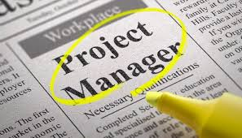
ENDLESS POSSIBILITIES
Right of Way Agents
Designers
Planning Staff
Surveyors
Environmental Coordinators
Utility Technicians

Slide 10
OPPORTUNITY TO SUCCEED

